Slide 1

PERSUASIVE DESIGN MODEL
BJ FOGG

Slide 2
DEFINITION
MODEL FOR BEHAVIOUR
MODEL AF 3 FAKTORER:
MOTIVATION
ABILITY
TRIGGERS
BRUGBAR, I ANALYSE OG DESIGN
OPFØRSEL SKIFT

Slide 3
MOTIVATION/TRIGGER/ABILITY
FBM
SKAL VÆRE MOTIVERET
SKAL HAVE MULIGHEDEN FOR AT UDFØRE OPGAVEN
SKAL TRIGGERET TIL AT UDFØRE

Slide 4
MOTIVATION
MODEL FOR BEHAVIOUR
TARGET BEHAVIOR
HIGH MOTIVATION
INCREASING LIKELINESS TO PERFORM TARGET BEHAVIOR
EXPECTATION MOTIVATION
FRYGT, HÅB, STOLTHED
PC COMPONENT IKKE PASSER ELLER PC IKKE TÆNDER
HIGH ABILITY

Slide 5
ABILITY
MODEL FOR BEHAVIOUR
TARGET BEHAVIOR
HIGH MOTIVATION
INCREASING LIKELINESS TO PERFORM TARGET BEHAVIOR
SIMPLICITY FACTOR:
PENGE
TID
FYSISK ANSTRENGELSE
DIGITAL PRODUCT
HIGH ABILITY

Slide 6
TRIGGER
MODEL FOR BEHAVIOUR
TARGET BEHAVIOR
HIGH MOTIVATION
INCREASING LIKELINESS TO PERFORM TARGET BEHAVIOR
DESIGNED TIL BRUGER MED INTERESSE I PC BYGGERI
EVNE MANGEL
FACILITATOR TRIGGER
HØJ MOTIVATION
TRIGGER
HIGH ABILITY

Slide 7
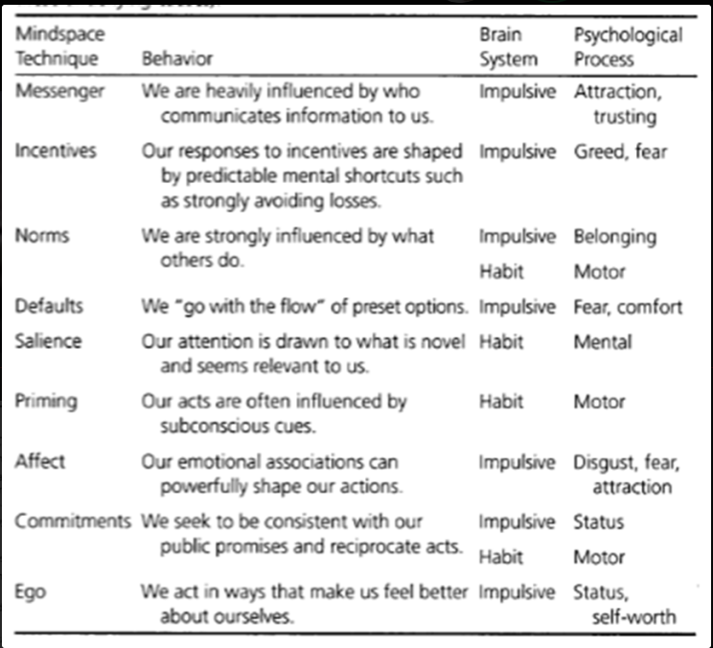
BJ FOGG | VLAEV
PERSPEKTIVERING
MOTIVATION
MOTIVATION GENNEM NUDGING
MOTIVERE BRUGERE GENNEM NUDGING
INCLUDERE NUDGING I FOGG MODEL

